Slide 1
Data Visualization
Presentation by William Munguti

Slide 2
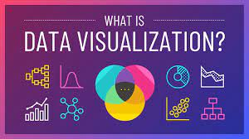
What is data Visualization?
Data Visualization is the act of transforming data that is in raw form into easily understandable pictures , charts, maps and graphs

Slide 3

Why is data Visualization necessary?
Helps provide quality information by transforming huge amounts of data into easily understandable pictures and graphics
Visually displaying data makes it more accessible and understandable for the human eye to apprehend large amounts if data.

Slide 4
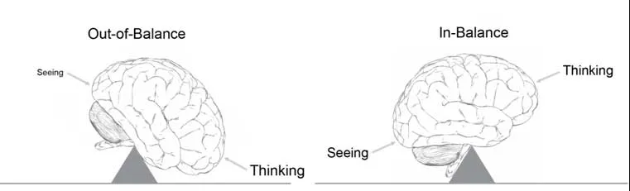
Why is data Visualization necessary?
The human brain is not able to understand or even just imagine large amounts of numbers or text at once.
Up to 50% of its activity focuses on visual processing only. Visuals are processed 60,000 times faster than simple text or numbers; an image requires just 13 milliseconds to be elaborated.

Slide 5
Why is data Visualization necessary?
Visually displaying data makes it much more accessible
It is critical for :
Identifying the weaknesses of an organization
Accurately forecasting trading volumes sale prices
Making the right business choices.

Slide 6
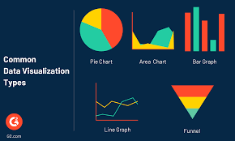
Types of Visualizations
Charts
Graphs
Tables
Maps

Slide 7
Charts & Graphs
Charts and graphs are perfect for comparing one or many value sets, and they can easily show the low and high values in the data sets.
Charts and graphs used for comparison include the following:
Histogram
Pie chart
Line graph
Scatter Plot graph

Slide 8
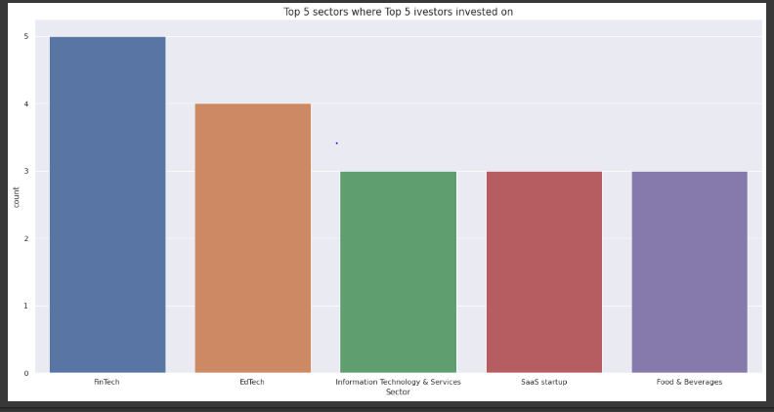
Histogram
Histograms can help you compare data between different groups or to track changes over time. Bar graphs are most useful when there are big changes or to show how one group compares against other groups.
Example

Slide 9
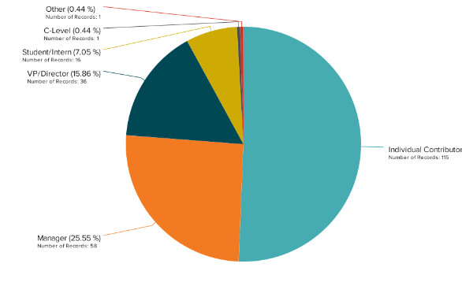
Pie Chart
A pie chart demonstrates a fixed number and how categories represent various elements that make up anything.

Slide 10
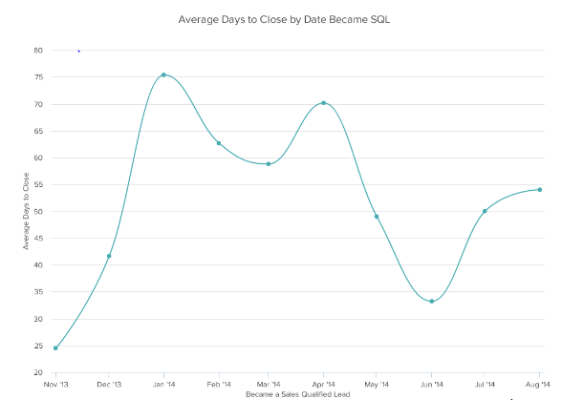
Line graphs
A line graph is used to display a wide range of data types and demonstrate trends or progress over time.

Slide 11
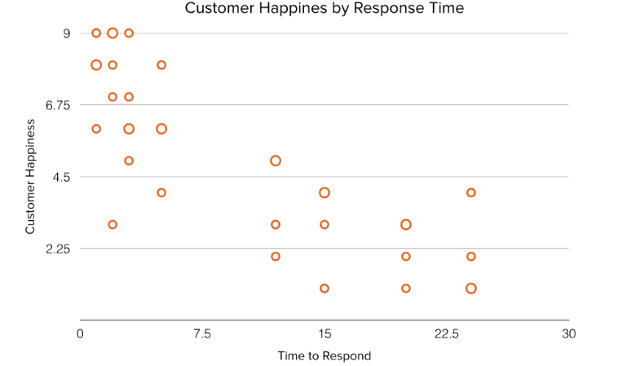
Scatter Plot
Scatter plots are helpful in situations where you have too much data to quickly see a pattern. They are best when you use them to show relationships between two large data sets.

Slide 12
Tables
Utilizing rows and columns, tables are a handy tool for information organization.
Tables can be used to convey information on their own or in conjunction with other types of data representation (like a graph).
Tables are useful for tracking frequencies, variable associations, and other information since they support a wide range of factors.

Slide 13
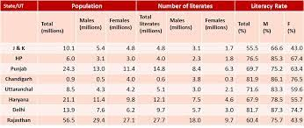
Tables

Slide 14
Maps
Data that is geographically relevant is analyzed, displayed, and presented via map visualization.
The distribution or percentage of data in each area can be seen visually.
Types of Maps :
Administrative maps
Heatmaps
Statistical maps
Trajectory maps
Bubble maps

Slide 15
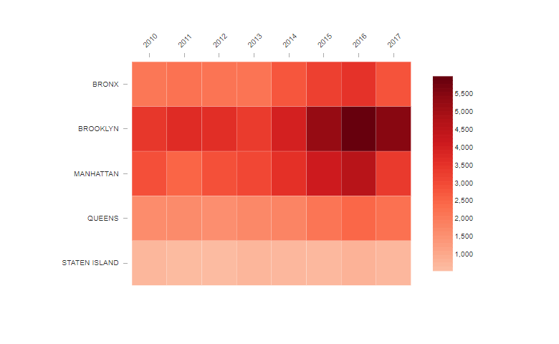
Maps
Most common type of map is the heat map

Slide 16
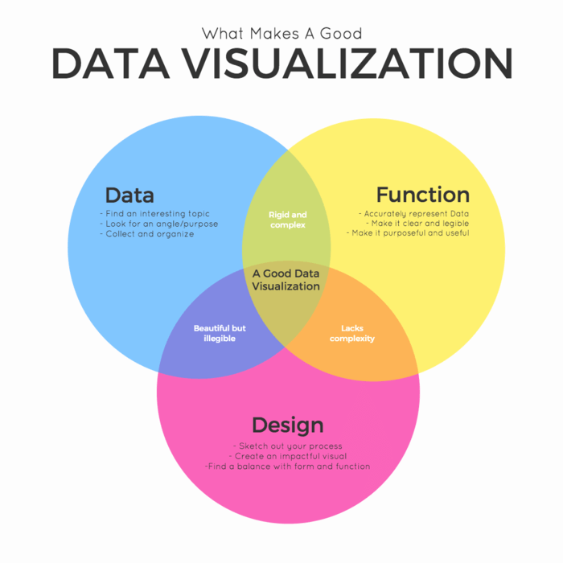
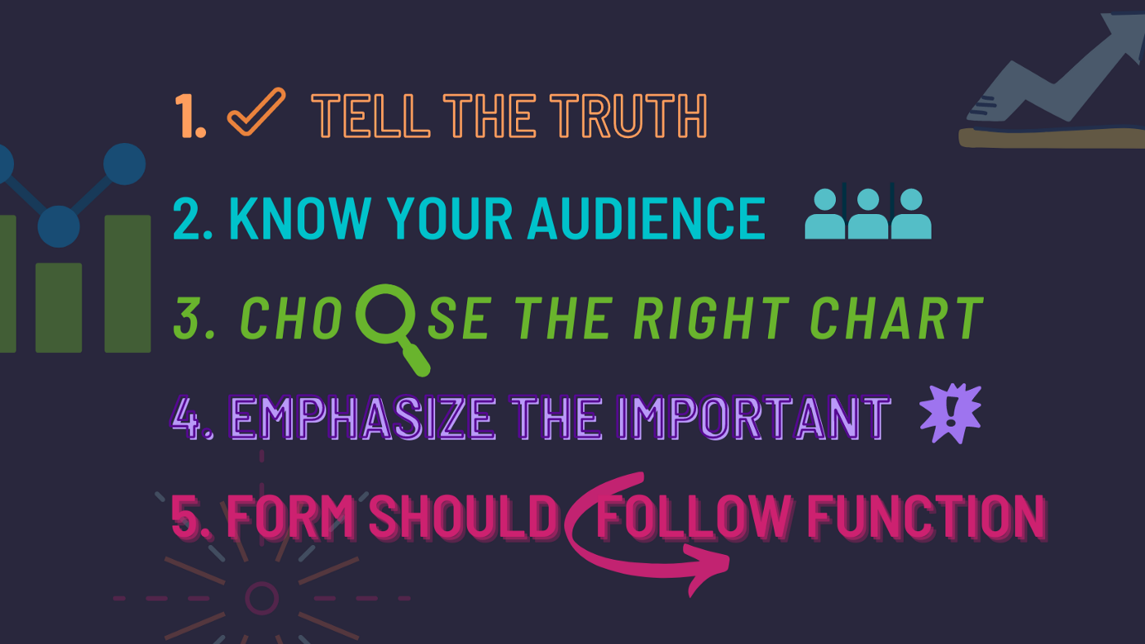
Cardinal Rules for Data Presentation

Slide 17

Cardinal Rules for Data Presentation
Keep it simple
Don’t overload a visual, report or dashboard with more information than is needed, but make it smart.

Slide 18

Cardinal Rules for Data Presentation
Emphasize important data
The most important data should immediately draw the user’s eye

Slide 19

Cardinal Rules for Data Presentation
Focus on Audience
Convey what wants to be seen by the intended users.
Understand what wants to be seen by the users and present the data accordingly with proper visualizations

